Slide 1
Fees for trading blocks of 10,000 lots and more

Slide 2
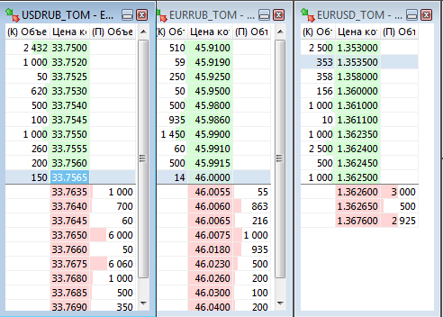
OBJECTIVE
Promoting members providing liquidity. Large makers’* trades should be discounted.
Orders of large size are almost absent in the spot order book
- Maker trade is a trade with order number less than the number
of its matching order.

Slide 3
Encouraging block trading
To boost liquidity in spot instruments on the FX market, the Exchange is to reduce the volume-based rate of the fee for makers’ trades of 10,000 lots and more:
The volume-based rate is reduced by 0.0002% for makers’ trades with an order of 10,000 lots and more.
Fee schedule | Order of < 10,000 lots | Order ≥ 10,000 lots
SPT_0 | 0.0015% | 0.0013%
SPT_1000 | 0.0010% | 0.0008%
SPT_2000 | 0.0008% | 0.0006%
- Maker trade is a trade with order number less than the number
of its matching order.

Slide 4
EXAMPLES
1
Trading member
(maker)
Fee rate: 0.0013%
Order: USD
10,000,000
Trading member
(taker)
Fee rate: 0.0015%
Trade:
USD 10,000,000
Order:
USD 12,000,000
2
Trading member
(maker)
Fee rate: 0.0013%
Order: USD
10,000,000
Trading member
(taker)
Fee rate: 0.0015%
Trade:
USD 5,000,000
Order:
USD 5,000,000

Slide 5
EXAMPLES
3
Trading member1
(maker)
Fee rate: 0.0015%
Order: USD
5,000,000
Trading member 2
(taker)
Fee rate: 0.0015%
Trade 1:
USD 5,000,000
Order:
USD 10,000,000
Residual 5,000 lots are entered on the book
Trading member 2
(maker)
Fee rate: 0.0013%
Order:
USD 5,000,000
Trading member 3
(taker)
Fee rate: 0.0015%
Trade 2:
USD 5,000,000
Order:
USD 5,000,000

Slide 6
THANK YOU

