Slide 1
G-curve: Zero Coupon Yield Curve for Government Bonds (OFZ)
2016

Slide 2
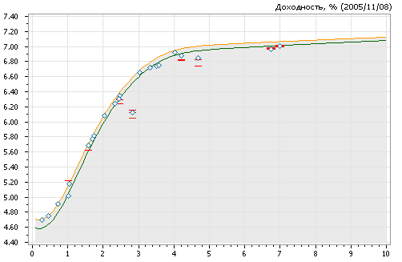
Overview
G-curve is a function Y(t) such that for some eligible set of OFZ actual and theoretical prices are as close as possible :
Y(t), %
real-time G-curve calculation
Current G-curve
YTM of trades
Theoretical YTM
according to current G-curve
The main features of the algorithm:
liquidity criteria for choosing issues 1:K
Y(t) in the form of modified Nelson-Siegel
Kalman Filter to calculate parameters
trade prices, bids/offers as input data
real-time and EOD curves
history of curves since 2003
G-curve EOD previous day
t, years
cash flows from the bond
(coupons, amortizations, redemption)

Slide 3
Selection Procedure for Eligible Issues
the list of OFZ issues used to calculate G-curve is reviewed monthly
the procedure starts with segregation of all issues into 3 groups by time to maturity:
3 months ÷ 2 years
2 ÷ 10 years
10+ years
in each group separately the total number of trades is divided to number of issues in a group to get an average trades number per issue ;
similarly an average volume per issue ;
an issue m is included in the list if , where L is a constant parameter for respective group
parameters are static parameters
static parameters are set and changed by the Expert Committee monitoring G-curve

Slide 4
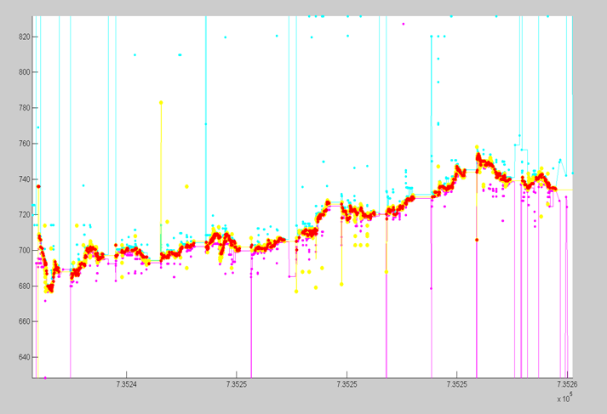
Pre-Processing of Input Prices
trade prices, bids, offers are converted into yield to maturity YTM
for each bond bestbid and bestoffer are taken
- short-living orders and
- orders of small volume
may be discarded
median over some period is calculated separately for trade YTM, bestbid, bestoffer
if resulting med_trade is out of the interval (med_offer, med_bid) it is corrected to the closest value
as result large price fluctuations are filtered out
YTM, bps
filtered out
time
trades in terms of YTM
trades in terms of YTM after smoothing
bids, if absent YTM = 10000 bps
offers, if absent YTM = 0

Slide 5
G-curve Parametric Form
Nelson-Siegel
additional terms for better fit
fixed parameters
- dynamic parameters to be defined from input prices
G(t), Y(t) in bps

Slide 6
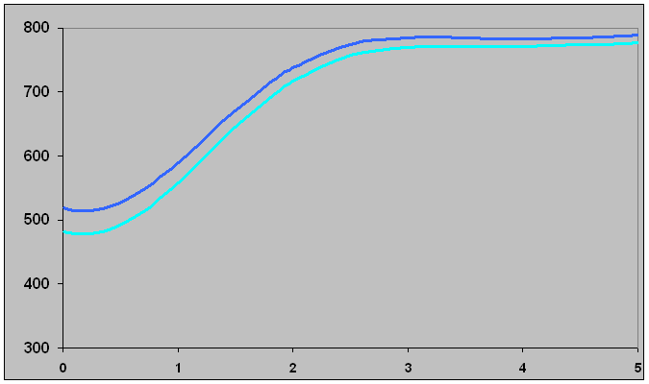
Kalman Filter – Trades (1)
each trade is considered as new “observation”
the vector of dynamic parameters x is updated after each trade
as result the curve is shifted to diminish the residual (“the innovation”)
accuracies (volatilities, covariance) of both x and the observation are taken into account to determine an optimal change of x
this method ensures smooth transformations of the curve trade-by-trade
residual
accuracy
G-curve before correction
G-curve after correction
An alternative method is to accumulate trades during some period of time and then try to fit the curve “at once”. In a not very liquid market this method has some disadvantages:
the accumulation period should be long enough to guarantee sufficient number of observations for various maturities
the curve can have significant jerks from one calculation to another

Slide 7
Kalman Filter – Trades (2)
To avoid instability, the Kalman Filter is simplified: the covariance matrix of x is static.
Extremely large residuals are truncated to prevent jumps of the curve.
The noise in observations is characterized by the variance
where is variance of k-th issue’s YTM fluctuations; - static parameters.
Algorithm:
If is current vector of dynamic parameters, - new observation,
- residual, - sensitivities of to
Then next vector of dynamic parameters is calculated recurrently:
for j=1, 2, 3, 4,
for j=5,…., 13

Slide 8
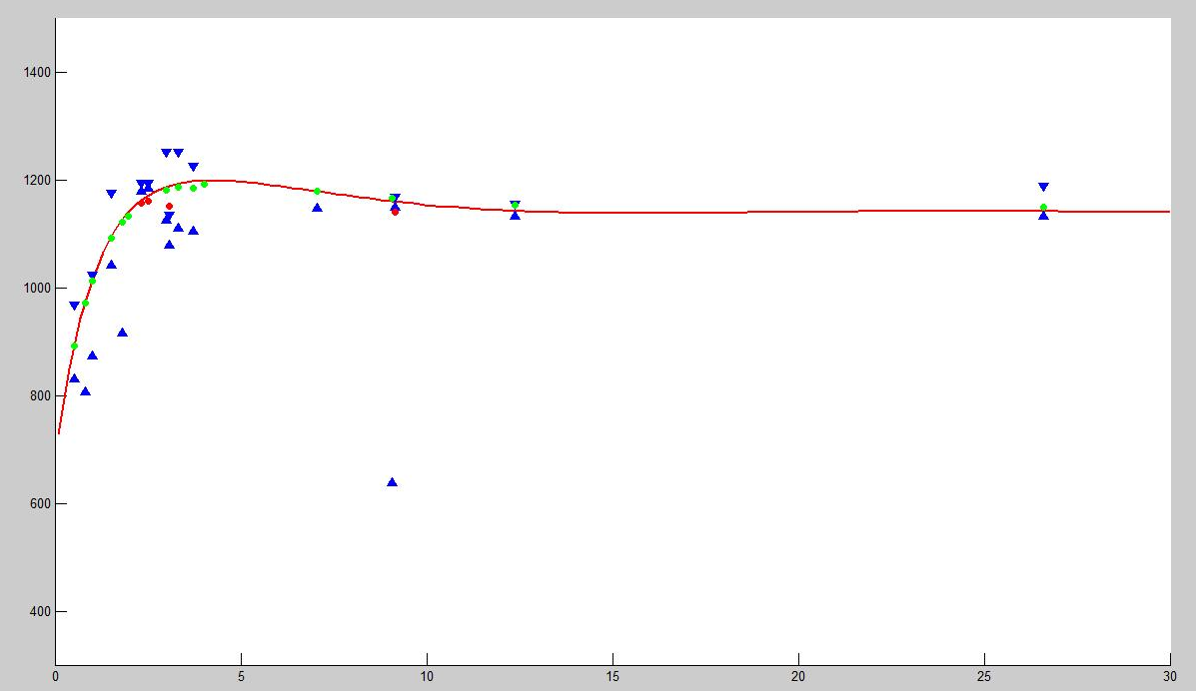
Kalman Filter - Bids/Offers
G-curve is checked against bid/ask borders:
bestoffer bestbid for all issues
Among outliers (if any) one is picked up. A “technical trade” is imitated with
or
This “trade” is processed in the same way as any ordinary “normal” trade
inside bid/offer
weights are assigned to issues according to the liquidity factors
the picked up issue:
max (outlying distance * weight)
outliers

Slide 9
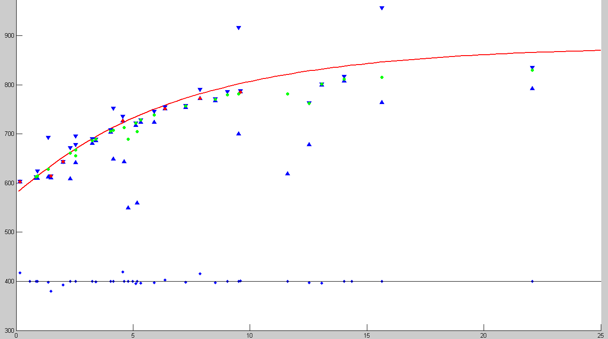
Process of Filtering
corrections

Slide 10
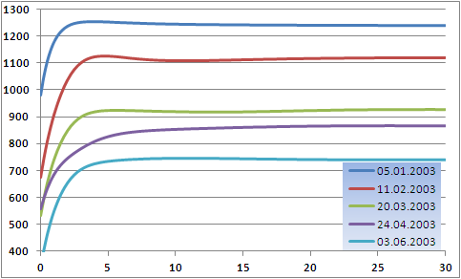
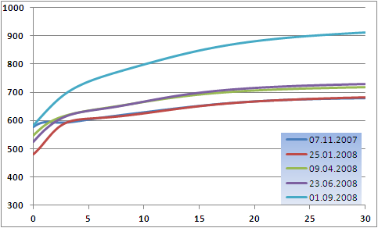
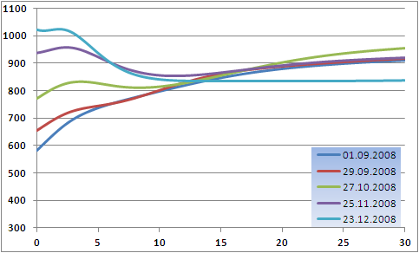
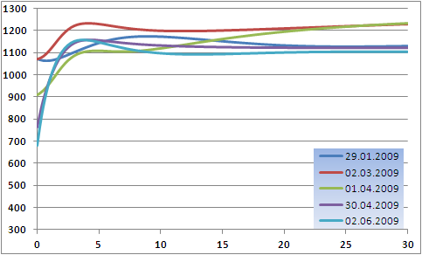
Some G-curves (1)

Slide 11
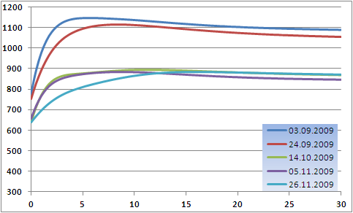
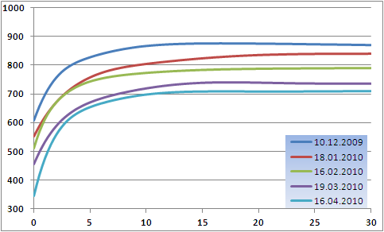
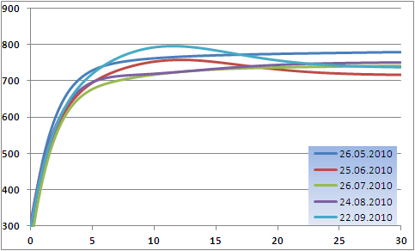
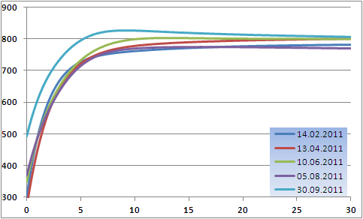
Some G-curves (2)

Slide 12
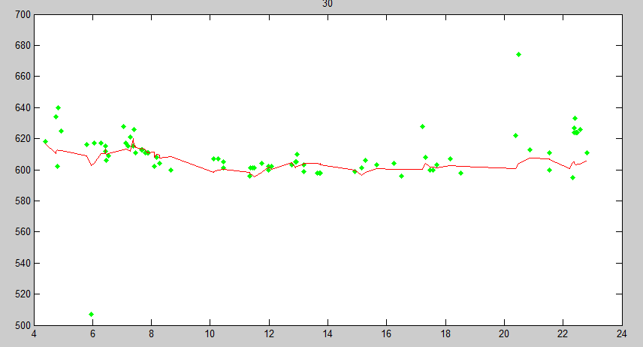
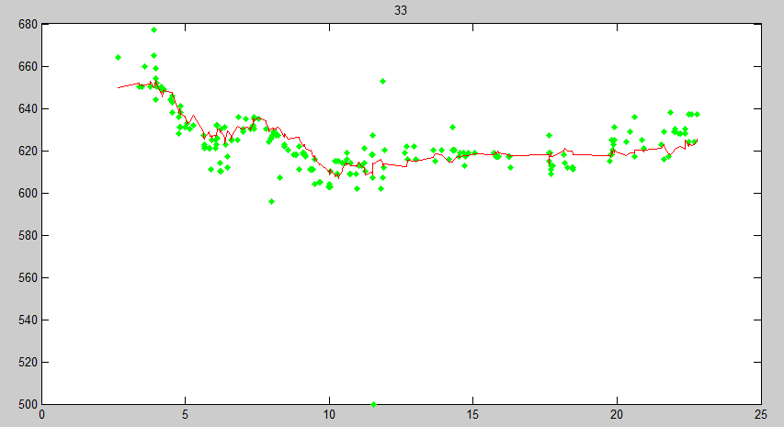
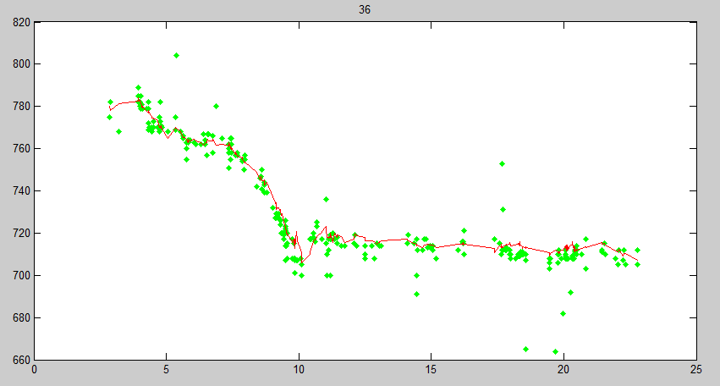
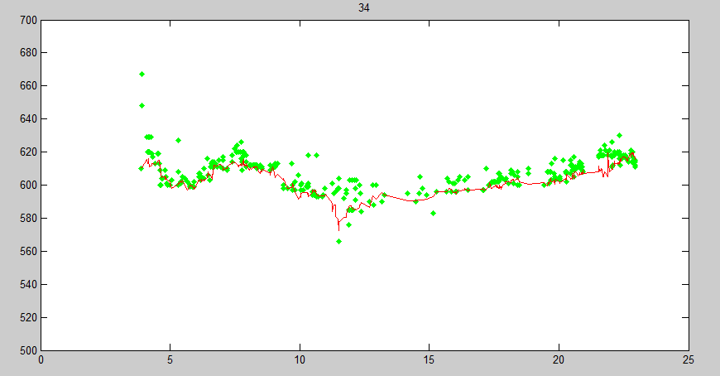
Results: vs from G-curve
is a good estimate of bond price, especially for less liquid bonds
SU25065RMFS2
SU25072RMFS8
SU25073RMFS6
SU25075RMFS1

Slide 13
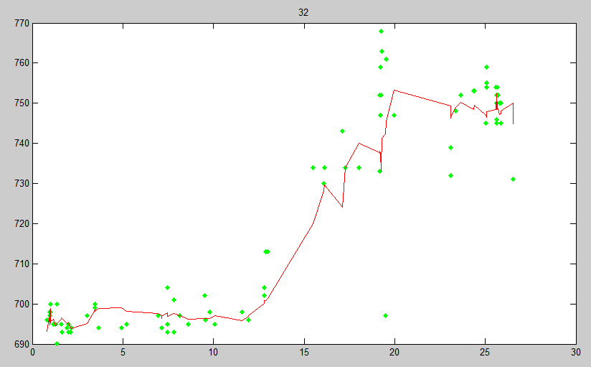
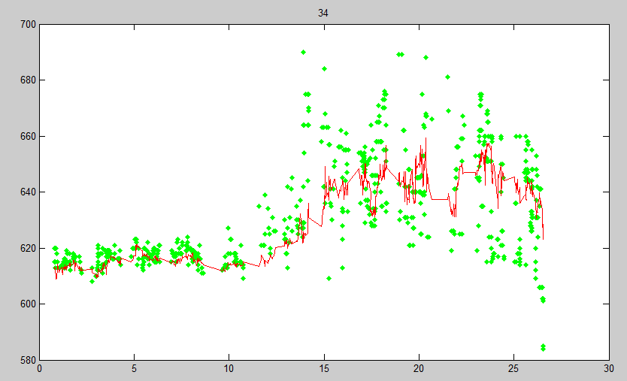
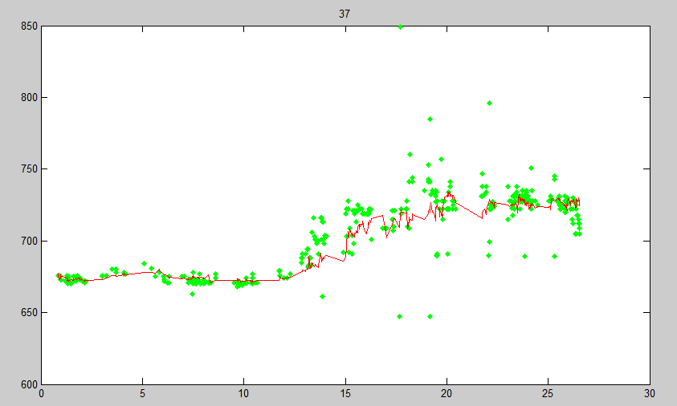
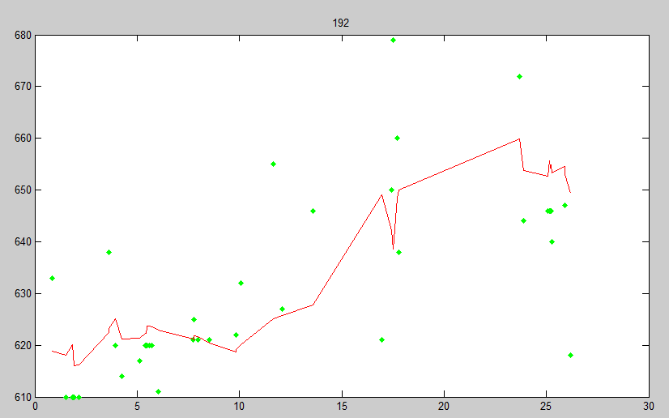
Results: vs from G-curve
SU225071RMFS0
SU25073RMFS6
SU25079RMFS6
SU26192RMFS4

