Slide 1
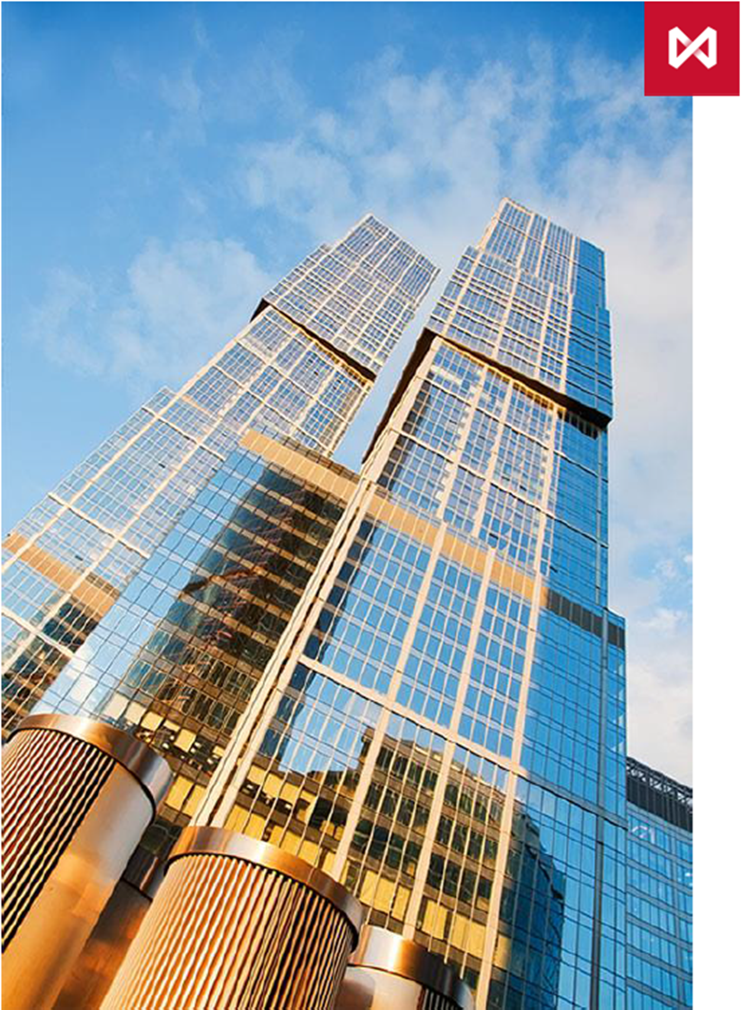
Segregated Accounts
on the Derivatives Market

Slide 2
What is segregation?
MOEX offers individual client segregation on the Derivatives Market
To segregate a client or a group of clients National Clearing Centre (NCC) opens special clearing register or a group of registers – segregated brokerage firm (SBF)
SBF is set up on a stand-alone Settlement Account
The collateral for SBF positions is calculated separately from collateral for the broker and other clients’ positions
SBF’s assets cannot be used to pay off the broker’s or its clients’ debts
SBF’s assets are protected even in case of the broker’s bankruptcy
SBF’s free margin can only be transferred to bank accounts assigned to the SBF
SBF’s positions and collateral can be transferred to another broker

Slide 3
Who benefits from using the service?
Segregation provides access to the Derivatives Market for clients who prefer to eliminate credit risk of Russian brokers:
non-resident clients – global brokers, funds, HNWCs
large resident clients – sub-brokers, corporates, HNWCs
Segregation gives Russian brokers an opportunity to attract new major clients and expand the list of customised services with high level of protection.

Slide 4
Protection of client’s assets
The broker provides a client with access to trading and clearing services while the Authorised Account Owner operates client’s assets.
Authorised Account Owner should meet the following criteria:
The client or a third party the client trusts
Legal entity
Resident or non-resident
Go through the Know-Your-Client procedure and conclude an agreement with NCC

Slide 5
Authorised Account Owner: functions
Register SBF (in cooperation with the broker)
Link SBF with own bank accounts for money withdrawal
Deposit and withdraw SBF’s money
Initiate transfer of SBF’s positions and collateral in particular cases
NCC is obliged to return SBF collateral to Authorised Account Owner, not the broker

Slide 6
Risk management and trading
SBF risks are not netted with risks of the broker or other clients.
Therefore SBF can use its free margin for opening positions or withdrawal even if the broker receives a margin call on other Settlement Account (proprietary or clients’) or a prohibition on trading transactions.
The broker may limit trading of the SBF and execute a mandatory close-out of its positions in accordance with its own regulations without waiting for NCC margin call on SBF Settlement Account.
For example, in case of high volatility NCC may expand price limits and increase margin requirements during the trading session, and it could lead to a large deficit of SBF’s free margin.

Slide 7
Risk management and trading (2)
NCC may initiate limitation of SBF’s trading activity and mandatory close out of SBF’s positions if:
SBF has failed to settle the margin call on its Settlement Account.
Other Settlement Account of the broker had an indebtedness that led to the use of the broker’s contribution to the Guarantee Fund. The broker did not refund his contribution during 2 settlement periods and the Authorised Account Owner did not use the right of transferring SBF’s positions to another broker during this period.
The broker’s banking license has been revoked, or a bankruptcy order has been made against it and the Authorised Account Owner did not use the right of transferring SBF’s positions to another broker within 2 days after the event.
The Authorised Account Owner always retains the right to withdraw free margin of the SBF.

Slide 8
Liquidity management
Depositing money | Withdrawal | Money transfer
Anyone can deposit money to SBF’s Settlement Account. | Withdrawal is possible only to Authorised Account Owner’s bank accounts and only on the basis of the order of Authorised Account Owner’s – or broker’s orders (if Authorised Account Owner allowed the broker to give such orders). | Money transfer from other broker’s Settlement Accounts to SBF’s Settlement Account is allowed. Money transfer from SBF’s Settlement Account to another Settlement Accounts is prohibited.

