Slide 1

“Corporate Governance of Spanish Listed Companies. Characteristics.
Moscow December 2018
Juan Munguira

Slide 2


Characteristics of the Corporate Governance Code
Since the OECD was established in 1961, it has developed some 270 legal instruments,
International standards (promoting integrity and good governance)
The anti-bribery convention is recognised as the golden standard

Slide 3
Characteristics of the Corporate Governance Code
Fight against transnational bribery and other forms of unfair competition
Promotion of integrity and transparency
Good governance in the public and private sectors

Slide 4
Characteristics of the Corporate Governance Code
- Flexible application
- “Comply or explain” approach
- The binding provisions / Spanish Company Law
- Principles in teh Corporate Governance Code
- Recommendations in the Corporete Governance Code
-Don´t replicate the relevant legal precepts among its recommendations

Slide 5
Characteristics of the Corporate Governance Code
- All those firms whose shares are admitted to trading on an official secondary market.
-All listed companies, whatever their size and market capitalisation
-Except where expressly indicated that a Recommendation is applicable only to large cap firms.

Slide 6
Characteristics of the Corporate Governance Code
A) Voluntariness subject to the “ comply and explain” principle.
a.1) Degree of compliance with Corporate Governance Recommendations, justifying any failure to comply”
B) Evaluation by the market
b.1) The task of evaluating the explanations will fall to shareholders, investors adn the market in general.

Slide 7
Characteristics of the Corporate Governance Code
- Explain clearly reasons for departing from Code Recomendations.
- Evaluation by the Market
- Listed companies must state their degree of compliance with each Recomendation

Slide 8
EU rules on non-financial reporting-.
- Apply to companies with more than 500 employees.
- Listed companies.
- Banks.
- Insurance companies.
- Other companies designated by national authorities as public-interest entities.

Slide 9
Information to be disclosed
- Environmental protection.
- Social responsability and treatment of employees.
- Respect for human rigths.
- Anti-corruption and briebery.
- Diversity on company boards (in term of age, gender, educational and professional background).

Slide 10
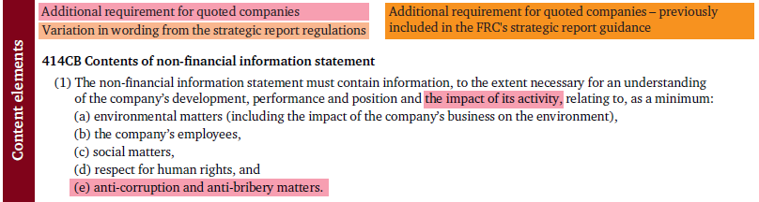
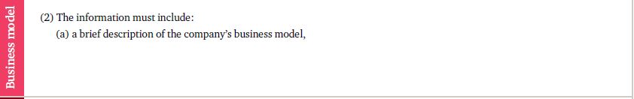
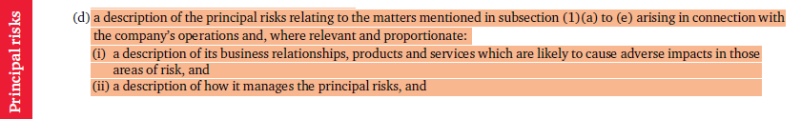

Slide 11
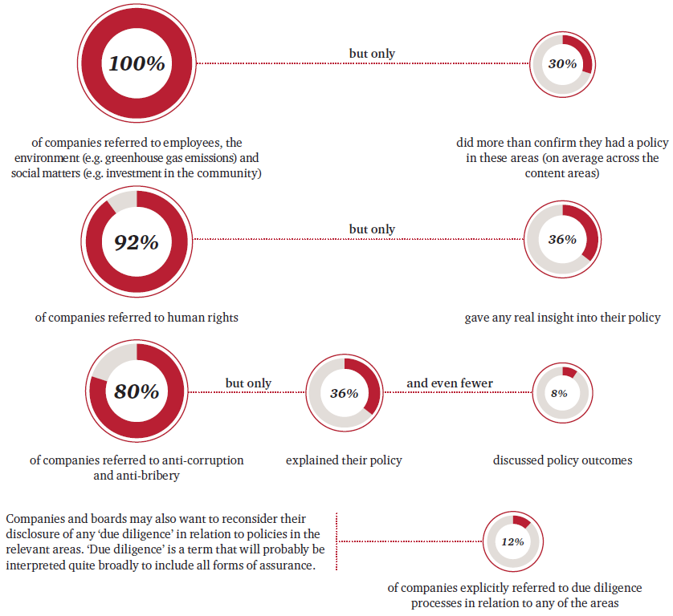

Slide 12
Principles. General arrangements
- There are 25 principles
- Principle 1 “ In general, companies should avoid by law clauses whose underlying purpose is to hinder possible takeover bids”.
- Listed companies should avoid the option of establishing bylaw restrictions to a possible takeover bid and change in ownership control

Slide 13
Principles. General arrangements
1-5
Principle 2. When various listed companies belong to the same group, they should take appropriate steps to safeguard the legitimate interests of all interested parties and to resolve conflicts of interest should they arise.

Slide 14
Recommendation 2
When a dominant and subsidiary company are both listed, they should provide detailed disclosure on:
a) The activity they engage inand any business dealings between them, as well as between the listed subsidiary and other group companies.
b) The mechanisms in place to resolve possible conflicts of interest.

Slide 15
Principles. General arrangements
1-5
Principle 3. Companies should give clear information to the GM concerning their degree of complaince with Good Governance Code recommendations.
Principle 5 Boards should make limited use of the delegated power to issue shares or convertible securities and inform shareholders appropiately about such use.

Slide 16
Principles. Shareholders´meeting
6-8
- The General meetings should be conducted according to principles of transparency and with appropriate information provided.
- The company should aid shareholders in execising their rights to attend and participate in general meetings in conditions of equality.
- Equality for all shareholders in exercising their rights to attend and participate in General Meetings.

Slide 17
Shareholders´ general meeting
- Principles of transparency and with appropriate information provided.
- The policy on general meeting attendance payments should be disclosed in full

Slide 18
Recommendation 6
Listed companies should publish in the web site at least
a) Report on auditor independence.
b) Reviews of the operation of the audit committee and the nomination and remuneration committee
c) Audit committee on third-party transactions
d) Report on corporate social responsibility policy

Slide 19
Principles . Board of directors
9-25
-The board of directors will be directly responsible individually and collectively for steering the company and supervising its management, with the goal of promoting the corporate interest.
- The board of directors should have the optimal size to facilitate its efficient functioning, the participation of all memebers and efficient decision making. The selection policy should seek a balance of knowledge, experience and gender.

Slide 20
Board of directors
- Responsible individually and collectively / s goal of promoting the corporate interest.
- The optimal size and balance of knowledge, experience and gender in the board´s membership.
- Large majority of non-executive directors and mix of proprietary and independent/ at least half of board places.

Slide 21
Cannot be delegated by the Board
- Approval of the general policies and strategies of teh board.
- Drafting of the annual accounts.
- The appointment and dismissal of managing directors.
-The call of the General Shareholder´s meeting.
- The content of the Agenda.

Slide 22
Recommendation 13
The board of directors should have an optimal size to promote its efficient functioning and maximise participation. The recommended range is accordingly between five and fifteen members.

Slide 23
Recommendation 52
The task osf supervising compliance with corporate governence rules, internal codes of conduct and corporate social responsibility should be assigned to one board committee or split between several , which clould be the audit committee, the nomination committee, the corporate social responsibility committee, where one exists, or a dedicated committee established ad hoc by the board.

Slide 24
Principles. Board of directors p11
- The board of directors should have a balanced membership, with a large majority of non-executive directors and adequate mix of proprietary and independent directors, which represent at least half of board places.
-The chairman is responsible for the leadership and efficient running of the board.
- The work of the board secretary is to facilitate the efficient running of the board.

Slide 25
Recommendation 15
Proprietary and independent directors should constitute an ample mjority on the board of directors, while the number of executive directors should be the minimum bearing in mind the complexity of the corporate group and the ownership interests they control

Slide 26
Recommendation 17
Independent directors should be at least half of all board members
However, when the company does not have a large market capitalisation, or when a ñlarge cap company has shareholders individually or concertedly controlling over 30 percent of capital, independent directors should occupy, at least, a third of board places.

Slide 27
Recommendation 18
Companies should disclose the following director particulars on their web site and keep them regularly updated
a) Background and professional experience.
b) Directorships held in other companies.
c) Statement of the director class to which they belong
d) Shares held in the company, and any options on the same

Slide 28
Recommendation 22
- Companies should establish rules obliging directors to disclose any circumstance that might harm the organisation,s name or reputation, tendering their resignation as the case may be, and, in particular, to inform the board of any criminal charges brought against them and the progress of any subsequent trial.

Slide 29
Principles. Board of directors p 18
- The board should periodically evaluate its overall performance and that of its members and committees.This evaluation should be externally facilitated at least every three years.
- The audit committee should be formed by a majority of independent directors. Its meembers, should be appointed with regard to their knowledge, and experience in accounting, auditing or risk management matters.

Slide 30
Recommendation 36
The evaluation of board committees should start from the reports they send the board of directors, while that of the board itself should stars from the report of the nomination committee.
Every three years, the board of directors should engage an external facilitator to aid in the evaluation process.

Slide 31
Recommendation 36
The board in full should conduct an annual evaluation , adopting, where necessary , an action plan to correct weakness detected iun:
a) the quality and efficiency of the board´s operation
b)The performance and membership of its committees
c)The diversity of board membership and competences

Slide 32
The Audit committee p 20
The audit committee should be formed by a majority of independent directors. Its members, particularly the chairman, should be appointed with regard to their knowledge and experience in accounting, auditing or risk maangement matters”.

Slide 33
Recommendation 40
Listed companies should have a unit in charge of the internal audit function, under the supervision of the audit committee, to monitor the effectiveness of reporting and control systems.
- With respecto to internal control
1) Monitor the inpreparation and integrity of the financial information
2) Monitor the independence of the unit handling the internal audit function

Slide 34
Recommendation 40
- With respect to the external auditor
1) Investigate the issues giving rise to the resignation of the external audit
2) Ensure that the remuneration does not compromise its quality or independence
3) Ensure that the external auditor has a yearly meeting with the board in full to inform about the company´s risk and accounting positions.

Slide 35
Principles. Board of directors p 21-22
- The company should maintain a risk control and management function in the charge of an internal unit or department, supervised directly by the audit committee. P21
- The nomination and remuneration committee, in large cap companies, should be split into two separate committees, should have a majority of independent members. p22

Slide 36
Recommendation 46
The risk and management function will have the following responsibilities:
a) The major risks of the company are correctly identified, managed and quantified.
b) Participàte actively in the preparation of risk strategies
c) Ensure that risk control and managemnet systems are mitigating risks effectively

Slide 37
Recommendation 50
Functions of the remuneration committee
a) Propose conditions for senior officer contracts.
b) Monitor compliance with the remuneration policy set by the company.
c) Periodically review the remuneration policy for directors and senior officers.
d) Ensure that conflicts of interest do not undermine the independence of any external advice the committee engages.

Slide 38
Director`s remuneration p25
Principle 25 “Remuneration policy should seek to further the corporate interest, while incorporating the necessary mechanisms to avoid excessive risk-taking or rewarding poor performance”.
2 “ The remuneration should not be so high as to compromise the independent judgement of non-executive directors”.

Slide 39
Director´s remuneration
The remuneration committee should consult with the company´s chairman and chief executive, especially on matters relating tom executive directors and senior officers.

Slide 40
Director´s remuneration
The remuneration should attract and retain the right people.
The remuneration should not be so high as to compromise the independent judgement of non-executive directors.
- Remuneration policy should seek to further corporate interest
- Avoid excessive risk-taking or rewarding poor performance

Slide 41
Director´s remuneration
Recommendation 59
“ A major part of variable remuneration components should be deferred for a long enough period to ensure that predetermined performance criteria have effectively been met”.

Slide 42
Corporate social responsibility
Principle 24 “The company should deploy an appropriate corporate social responsibility policy, as non-delegable board power, and report transparently and in sufficient detail on its development, application and results”.

Slide 43
Corporate social responsibility
Recommendation 54 “ the corporate social responsibility policy should specify at least:
- The goals of its corporate social responsibility
- The corporate strategy with regard sustainability, the environment and social issues
-Concrete practices in matters relative to: shareholders, employees, clients, suppliers, diversity, fiscal responsibility, human rights and the prevention of illegal conducts.

Slide 44
Corporate social responsibility
-Recommendation 55 “ The company should report on corporate social responsibility developments in its directors´ report or in a separate document, using an internationally accepted methodology.”

Slide 45
Corporate Social responsibility
-The systems for monitoring the results of the practices and identifying and managing related risks
-The mechanisms for supervising non-financial risk, ethics and business conduct
-Channels for stakeholders communication, participation and dialogue.
- Responsible communication practices / prevent the manipulation of information.

Slide 46
