Slide 1

Developments in Global Capital Markets
Equity Ownership
and Corporate Bonds
Mats Isaksson, OECD
MOSCOW
13 November 2019

Slide 2

Owners of the World’s Listed Companies
The combined market value of the world’s listed companies is about USD 80 trillion. This is equivalent to the global GDP.
Considering the significance of the world’s listed companies, who owns them and how these owners perform their role as shareholders is of economy-wide importance.
This not only affects the amount of risk capital that is made available to independent entrepreneurs who can challenge the status quo by developing new technologies and products. It also affects how well the performance of existing corporations is scrutinised and how strategic decisions about their future direction are made.

Slide 3
Why should we care?
The effect of an increase in passive indexed investing on shareholder scrutiny and small growth company listings. Today, institutional investors holdings represent 41% of the global market capitalisation, much of which is in the form of passive indexing. When passive indexing is used as an investment strategy, the scrutiny of risks and opportunities in individual companies could be neglected.
The political influence on listed companies resulting from significant public sector ownership. The public sector owns 14% of global market capitalisation and in almost 10% of the world’s largest listed companies the public sector holds over 50% of equity capital. Public sector ownership at this level gives rise to questions about how political priorities may influence decisions in listed companies and the economic effects on ultimate beneficiaries such as tax-payers and pensioners.
The widespread concentration of ownership in individual companies. In half of the world’s listed companies, the three largest shareholders hold more than 50% of the capital. This may indeed help overcoming the so-called agency problem in companies with widely dispersed ownership. But it may also increase the scope for abusing the rights of other shareholders and, if not properly regulated, jeopardise market confidence.

Slide 4
Owners of listed companies and the size of markets
Investor’s holdings
Global market capitalisation by region
Source: OECD (2019), Owners of the World’s Listed Companies, FactSet, Thomson Reuters Eikon, Bloomberg.
Institutional investors is the largest category of investors in public equity markets holding 41% -USD 31 trillion- of the global market capitalisation.
The public sector holds 14% of the global market capitalisation followed by private corporations (11%) and strategic individuals (7%).
The Asian region and the United States are the largest markets in the world accounting for 38% and 34% of the global market capitalisation respectively.

Slide 5
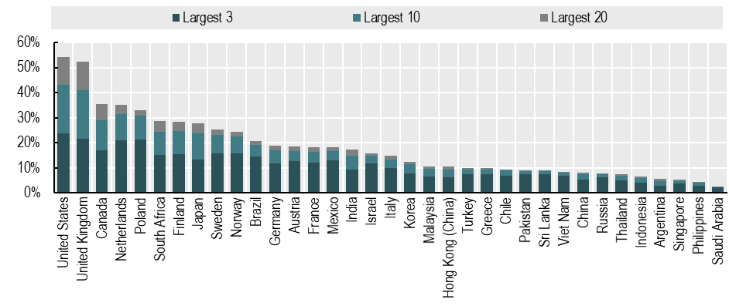
Largest institutional investors’ ownership at the company level
Equity owned
Source: OECD (2019), Owners of the World’s Listed Companies, FactSet, Thomson Reuters Eikon, Bloomberg.
Institutional investors are dominant owners in the United States, the United Kingdom and Canada. In these markets, on average the combined holdings of the 10 largest institutional investors represent more than 29% of a company’s equity capital.
In 10 of the world’s 35 largest markets, the largest 3 institutional investors own more than 15% of the equity capital.
In the United States the largest 20 institutional investors own almost 54% of the public equity capital.

Slide 6
The public sector is the second largest category of owners holding 14% of global equity capital
Market cap. weighted average
Source: OECD (2019), Owners of the World’s Listed Companies, FactSet, Thomson Reuters Eikon, Bloomberg.
The public sector holds 14% of the global market capitalisation at a total value of USD 10 trillion.
Central and local governments are the largest public sector owners accounting for 56% of public sector ownership of listed companies.
In about 8% of the world’s listed companies, the public sector owns over 50% of equity capital.

Slide 7
Private corporations and strategic individuals are important investors in Emerging Asia and Latin America
Market cap. weighted average
Source: OECD (2019), Owners of the World’s Listed Companies, FactSet, Thomson Reuters Eikon, Bloomberg.
Private corporations and strategic individual investors hold an 11% and 7% share of the global equity market respectively.
In 20 markets, private corporations and holding companies hold at least 20% of equity capital.
Markets where private corporations and holding companies are prominent owners include Chile (55%), Philippines (48%) and Turkey (40%).
In Mexico, strategic individuals and families are important investors holding 34% of listed equity.

Slide 8
Ownership concentration is common in listed companies around the world
Ownership distribution by concentration level
Largest shareholder
Largest 3 shareholders
Per cent of listed companies
Per cent of listed companies
Source: OECD (2019), Owners of the World’s Listed Companies, FactSet, Thomson Reuters Eikon, Bloomberg.
The 3 largest owners hold more than 50% of equity capital in half of the world’s largest listed companies.
In 3 out of 4 companies the 3 largest owners hold more than 30% of equity capital.

Slide 9
Ownership concentration at the company level
Share of companies where the largest or three largest shareholder(s) own over 50% of equity
Per cent of listed companies
Source: OECD (2019), Owners of the World’s Listed Companies, FactSet, Thomson Reuters Eikon, Bloomberg.
In half of the markets 4 out of 10 listed companies have a single owner holding more than 50% of equity capital.
In Argentina, Russia and Indonesia, more than 70% of the companies have a single shareholder holding more than half of equity capital.

Slide 10
Almost 25% of stock market investments are cross-border
Market cap. weighted average
Non-domestic ownership in selected markets
Source: OECD (2019), Owners of the World’s Listed Companies, FactSet, Thomson Reuters Eikon, Bloomberg.
Non-domestic investors are important owners in the Netherlands, the United Kingdom and Brazil.
The largest category of foreign investors is institutional investors: in half of the markets they account for more than 50% of all non-domestic ownership.
Almost 75% of the cross-border investments in public equity markets are held by investors domiciled in the United States and Europe.

Slide 11
Corporate governance implications
As capital markets evolve, the owners of public equity and their incentives also change.
Worldwide, a range of different ownership structures co-exist, creating new challenges for policy makers to ensure sound market incentives for capital formation and effective capital allocation.
New important categories of owners such as the public sector and other companies today own around 25% of the capital in the world’s listed firms.
Particularly in advanced markets, there is a concentration of ownership in the hands of a limited number of institutional investors.
Today, also cross-border investments account for almost one-quarter of the investments in public equity markets in the world.
To reap the full benefits of increased global integration it will be important that the core standards of the G20/OECD Principles of Corporate Governance with respect to equitable treatment, stakeholder rights, transparency and the rule of law are met and implemented in national contexts.

Slide 12
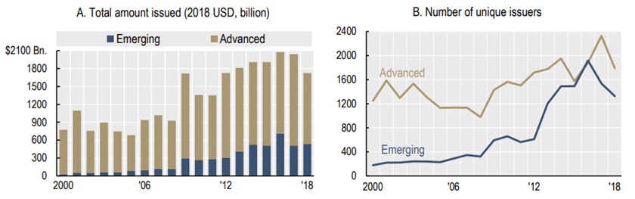
Global trends in corporate bond issuance
Corporate bond issuance by non-financial companies (in real terms, 2018 USD, billion), and number of issuers
Source: OECD (2019), Corporate Bond Markets in a Time of Unconventional Monetary Policy, Thomson Reuters Eikon.
Significant increase in the use of corporate bonds since the 2008 financial crisis.
Both in terms of volume raised and the number of issuing companies.
2000-2007: 864 billion/year. 2008-2018: USD 1.7 trillion/year
Greatest growth rate from low levels in emerging markets.

Slide 13
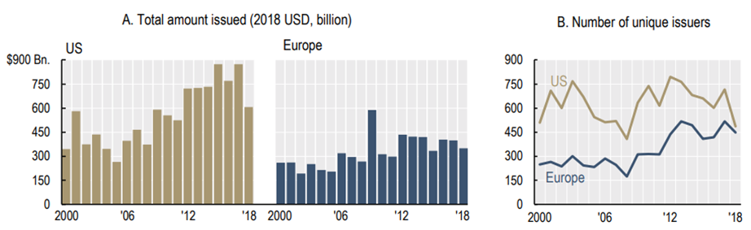
Trends in Europe & US
Corporate bond issuance by US and European non-financial companies
Source: OECD (2019), Corporate Bond Markets in a Time of Unconventional Monetary Policy, Thomson Reuters Eikon.
US pre-2008 annual average USD 401 bn. Post 2008 annual average USD 668 bn. (66% increase.
Europe pre-2008 annual average USD 250 bn. Post 2008 annual average USD 385 bn. (54 % increase)
Europe has seen a larger increase than US in the number of unique issuers.

Slide 14
Rapid increase in outstanding amount
Total outstanding amount of corporate bonds issued by non-financial companies (2018 USD, trillion)
Source: OECD (2019), Corporate Bond Markets in a Time of Unconventional Monetary Policy, Thomson Reuters Eikon.
The outstanding amount of corporate bonds issued by non-financial companies reached almost USD 13 trillion at the end of 2018. This twice the amount in real terms that was outstanding in 2008.
European issuers account for approximately 20% of the outstanding amount. And US issuers for about 45%.
Total repayments/refinancing needs in 3 years - about USD 4 trillion.

Slide 15
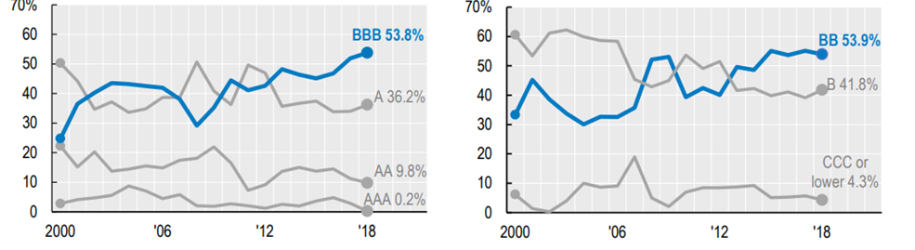
Composition of the investment and non-investment grade categories
Investment grade bonds
Non-investment grade bond
Source: OECD (2019), Corporate Bond Markets in a Time of Unconventional Monetary Policy, Thomson Reuters Eikon.
Continuous and significant increase in BBB rated bonds within the investment grade segment. Reached almost 54% at year end 2018.
This is the highest share that BBB issuance reached in our dataset, which goes back to 1980.

Slide 16
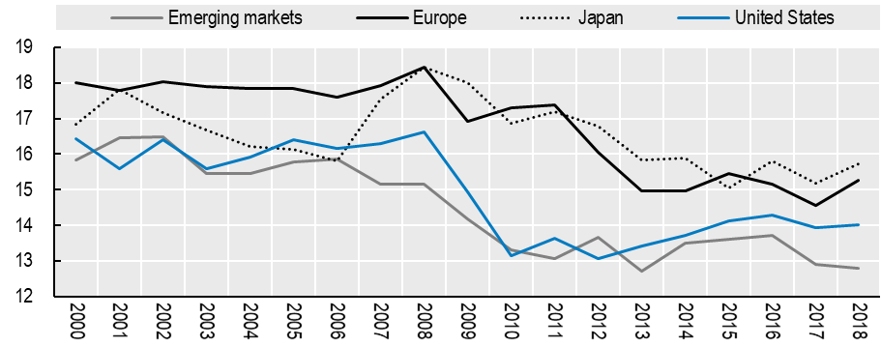
Corporate bond rating quality
Corporate bond rating index for different geographical regions
Source: OECD (2019), Corporate Bond Markets in a Time of Unconventional Monetary Policy, Thomson Reuters Eikon.
Our “corporate bond rating index” looks at the combined effects of changes in the composition of the investment and non-investment grade segments.
The index assigns a score of 1 to a bond if it has the lowest credit quality rating and 21 if it has the highest rating. Weighted average of individual bond scores.
For Europe, the continued decrease is associated with the 2011 crisis.

Slide 17
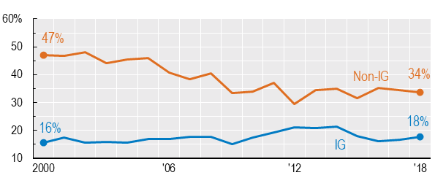
Decrease in bondholder rights
Covenant protection index for bonds issued by non-financial companies
Source: OECD (2019), Corporate Bond Markets in a Time of Unconventional Monetary Policy, Mergent FISD.
Covenants are clauses in a bond contract designed to protect bondholder rights.
Our covenant protection index tracks the presence/absence of 27 different types of covenants in the bond contract.
Compared to the pre-2008 period, there has been a marked decrease in the use of key covenants for non-investment grade bonds.
As a result, the gap between covenant protection for investment grade and non-investment grade bonds has narrowed.

Slide 18
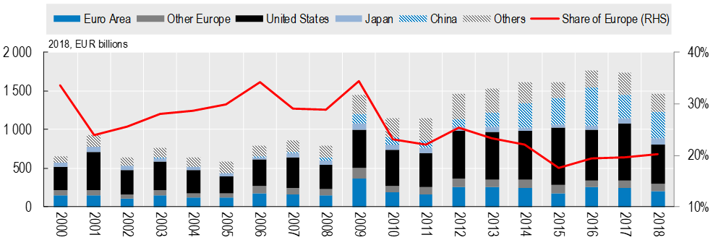
Share of European non-financial companies
Global corporate bond issuance by non-financial companies
Source: OECD (Forthcoming), Capital Market Review of Italy.
While the total issuance amount decreased to EUR 1.5 (USD 1.7) in 2018, the long-term trend has been upward in all regions.
Since the increase in some other markets, particularly China, has been higher compared to Europe, the share of European companies in global corporate bond proceeds dropped from 29% in 2008 to 20% in 2018.

Slide 19
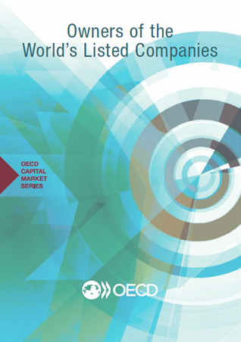
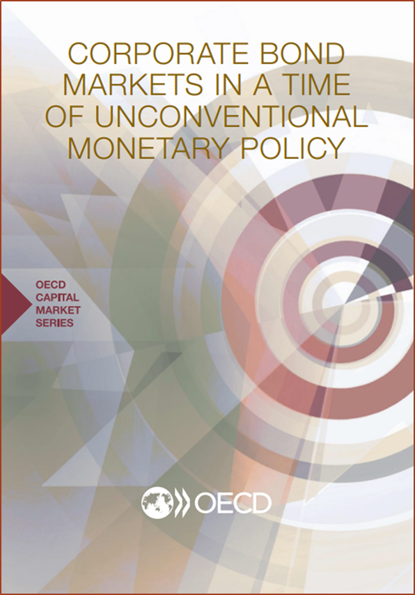
OECD Capital Market Series

Slide 20
Want to know more ?
Just Google:
OECD Capital Markets

