Slide 1
moscow exchange conference CORPORATE GOVERNANCE in RUssia – 2019 Responsible business conduct
Cristina Tébar Less
Acting Head
OECD Centre for Responsible Business Conduct

Slide 2
What is Responsible Business Conduct?
Ensuring a positive contribution by business to sustainable development while avoiding negative impacts (do good while doing no harm)
Focus is on impacts of business operations on people, environment, society
Responsibility covers companies’ own operations and supply chains
RBC should be part of core business and risk management
Goes beyond philanthropy and beyond “just” compliance with the law
Is expected from all businesses (MNEs, SMEs, SOEs, financial sector)

Slide 3
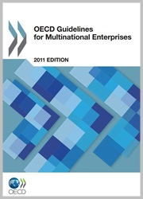
OECD Guidelines for Multinational Enterprises
Most comprehensive International standard on responsible business conduct
Recommendations from governments to businesses
Adopted by all OECD members and open to non-OECD members
Includes strong government commitment : National Contact Points
Oversight by OECD Working Party on Responsible Business Conduct
Notes:
Adopted in 1976 and regularly updated
Recommendations from governments to businesses- non binding, but many recommendations are now embedded in legislation
Open to non-OECD members (currently 48 adherents)
Apply to companies operating in or from adhering countries
Include government commitment to implement and promote the Guidelines and provide a grievance mechanism: National Contact Points
2011 Update: New chapter on human rights; focus on impacts through supply chains (cause-contribute-directly linked), risk-based due diligence

Slide 4
Alignment between OECD, UN and ILO standards
UN Guiding Principles on Business and Human Rights
ILO Tripartite Declaration of Principles concerning Multinational Enterprises and Social Policy
+ environmental, anti-bribery, corporate governance instruments
Expectation that companies behave responsibly by identifying, avoiding and addressing negative impacts that they
cause,
contribute to
or are directly linked to through a business relation
Key tool: due diligence
Notes:
OECD Guidelines are aligned with the UN Guiding Principle on Business and Human Rights (2011) and the ILO Tripartite Declaration of Principles concerning Multinational Enterprises (last updated in 2017). All three contain the expectation that companies carry out due diligence to identify, avoid and address adverse harms , including in their supply chains

Slide 5
By implementing the Guidelines and addressing adverse impacts, companies contribute to the implementation of most SDGs
Disclosure
Human Rights
Employment & Industrial Relations
Environment
Consumer interests
Science & Technology
Combating Bribery, Bribe Solicitation and Extortion
Taxation
Competition

Slide 6
DRIVERS OF RBC
Legislation on due diligence and disclosure of RBC strategies
Lawsuits against companies for human rights and environmental issues.
Investor and shareholder requirements on companies to adopt and report on responsible business conduct.
Consumer power, both from individuals and collective action through social media and ‘mega’ campaign groups.
Public benchmarking of companies on responsible business conduct, supported by investors.
Scrutiny from governments on supply chain activities.

Slide 7
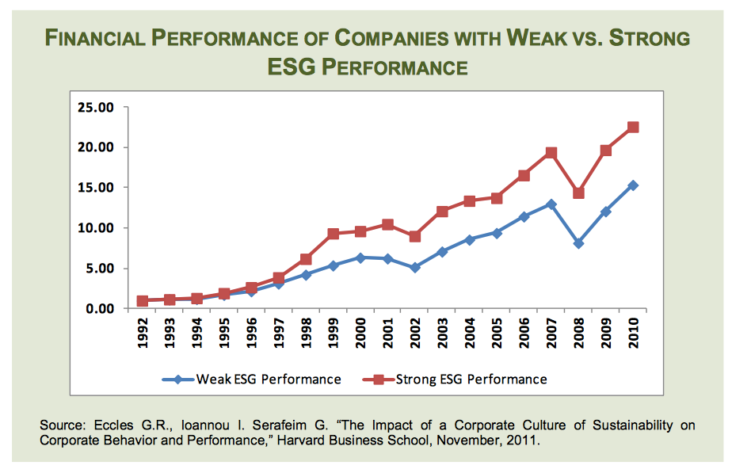
BENEFITS OF RBC
Reduce risks and manage reputation
Obtain and retain the social license to operate
Protect existing value and create new value
Facilitate the participation in global value chains
Attract and retain talent - increase productivity
Distinguish from competitors and access new markets

Slide 8
OECD’s work on RBC
Helping business to conduct due diligence for RBC
Outreach to business and government beyond adherents
Supporting Government policies for RBC
Strengthening NCPs
OECD Guidelines for Multinational Enterprises

Slide 9
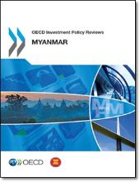
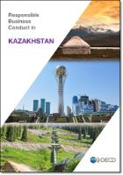
1. Supporting government policies for RBC
Meetings of the Working Party on RBC – all governments adhering to the OECD Guidelines for MNEs
Workshops on emerging issues relevant to RBC (gender, digitalisation, non-financial disclosure)
Support enabling policy frameworks for RBC
Advice on domestic and international policy developments on RBC
Inputs into G7, G20, APEC

Slide 10
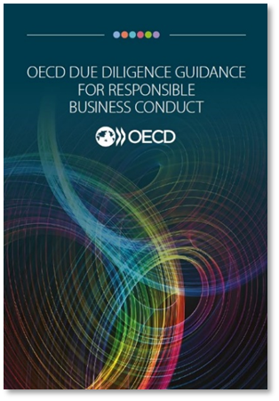
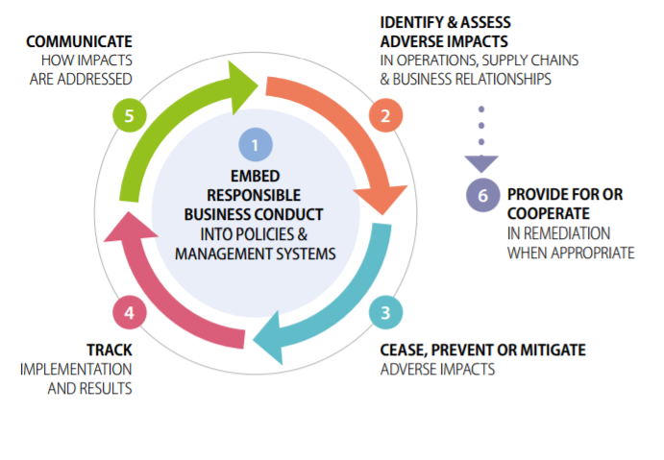
2. Helping business to conduct due diligence for RBC
Companies are expected to conduct due diligence to identify and address adverse impacts from their operations and through their business relations (including supply chains)
Notes:
Ongoing, non-linear process.
As a foundation it is important to have a policy and embed RBC into policies and management systems.
Then the due diligence approach requests that impacts be identified on an ongoing basis and very importantly once they are identified that efforts be made to cease, prevent or mitigate them.
In addition to identifying and responding to impacts enterprises are expected to track implementation and results to ensure that it is effective and make changes as necessary and lastly to communicate on how impacts are addressed. Communication is the key aspect of “showing” due diligence is being adequately implemented and is important for companies with respect to their stakeholder engagement.
Remediation is also an important process with respect to DDG but an independent expectation. Where an enterprise C or C it should provide for or cooperate in remediation of an adverse impact.

Slide 11
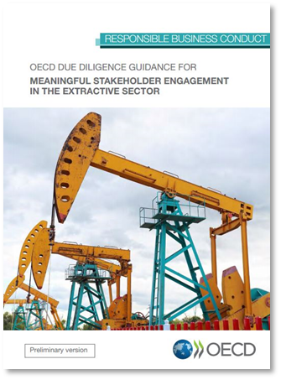
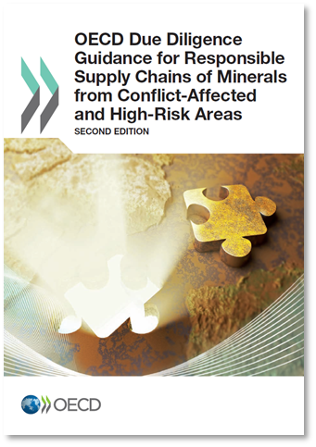
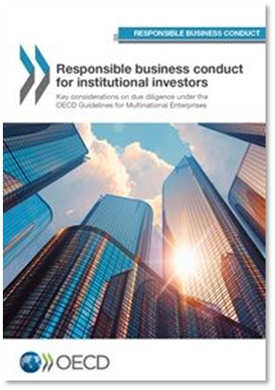
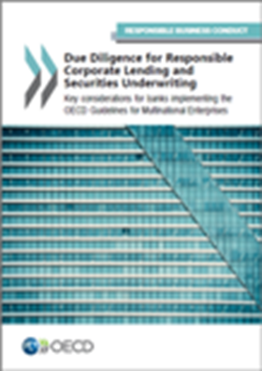
Sector guidance
Guidance for RBC in key sectors: minerals, extractives, garment and footwear, agriculture, financial sector
Tailored to key risks and opportunities in each sector
Support to companies (e.g. through pilot projects)
Cooperation with industry groups and initiatives
Financial sector is one of key sectors (institutional investors, corporate lending, project finance)

Slide 12
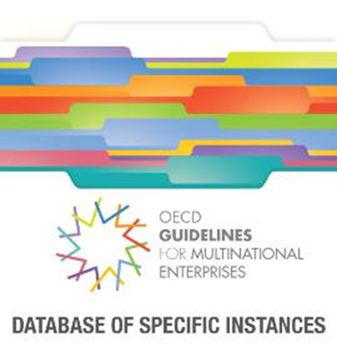
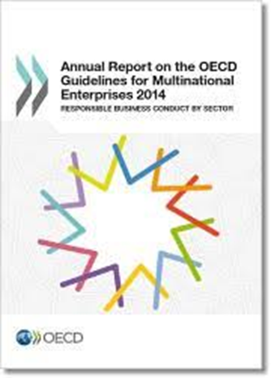
3. Strengthening National Contact Points
NCPs are set up by governments to handle RBC issues related to companies’ impacts
Non-judicial mechanism, mediation and problem solving
Over 450 cases since 2000
Financial sector increasingly targeted

Slide 13
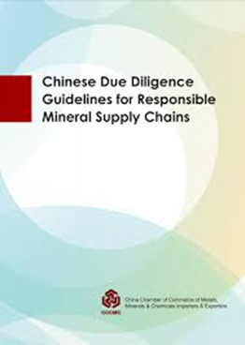
4. Outreach to business and government beyond adherents
Development of RBC standards
Integration of RBC in policy developments
Training to companies
Global Forum on RBC
Translations
Master Class on Risk-Based Due Diligence - ASIA

Slide 14
Further information
Responsible Business Conduct
http://mneguidelines.oecd.org
Due diligence
http://mneguidelines.oecd.org/duediligence
Investment/RBC Policy Reviews
https://www.oecd.org/investment/countryreviews.htm

