Slide 1
2016
MOSCOW EXCHANGE Client Access
Disclaimer: This presentation is for general information and educational purposes only.

Slide 2
FX MARKET STRUCTURE AND DYNAMICS
Notes:
Объем торгов
Дневной максимум – $47,3 млрд (03.03.14)
Среднедневной за 2014 г. – $23,8 млрд
534 Участников торгов (40 некредитных организаций и 494 банков)
Основные валютные пары: USDRUB (84% объема) и EURRUB (13%)
В фев.15 доля брокеров на ВР достигла 10%
В 2014 наблюдался рост доли FX Московской биржи на российском рынке:
в целом по межбанковскому рынку с 30,6% в 2013 до 42,1% в 2014
по доллар-рубль с 34,8 до 49,8%
по евро-рубль с 56,6 до 64,1%
по евро-доллар с 3,6 до 6,2%

Slide 3
FX MARKET COMPETITIVENESS
Share of the regulated market increased
In 1 H\Y 2016, the Moscow Exchange’s share in on the Russian FX market increased:
From 53.4% of the interbank market in 2015 to 46.0%
From 49.8% to 60,9% for USD/RUB;
from 6.2% to 8.7% for EUR/USD;
from 63.6% to 80.2% for EUR/RUB
In 1 H\Y 2016, the Moscow Exchange FX market share made against the world’s largest FX platforms:
EBS/ICAP – 24,6%
Thomson Reuters – 20,3%

Slide 4
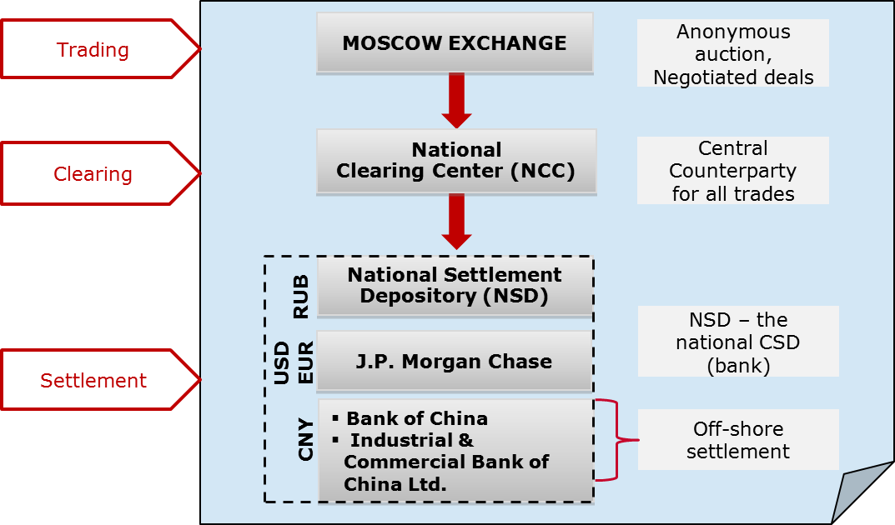
FX TRADING, CLEARING & SETTLEMENT
INFRASTRUCTURE
Guaranteed execution of transactions and settlement: National Clearing Center (NCC) as CCP
Sound RM system, adaptive margining requirements
RUB settlement via National Settlement Depository (NSD)
USD, EUR settlement via J.P. Morgan Chase Bank, GBP - via HSBC, CNY settlement via Bank of China, ICBC

Slide 5
MOEX FX SPONSORED DMA
Client`s share in the total SPOT FX trading volume
The first phase of DMA for non-resident institutions and non-bank Russian entities to the Moscow Exchange FX Market was launched in October 2010.
The second phase was introduced in Feb 2012. Key features include separate clearing accounts for the client and registration of sub-broker clients.
The number of registered clients exceeded 730,000 ↗ as of the 1H\Y of 2016
Client operations are concentrated mainly in SPOT instruments with the share exceeded 59 % ↗ of total SPOT turnover by the 1H\Y of 2016

Slide 6
MOEX SPONSORED ACCESS OVERVIEW
Clients
Prime Broker
Individuals
FX Market Participant
Bank or Broker/Dealer
Legal Entities
Institutional Investors
Financial Institutions
FI's
Clients
FI's
Clients
FI's
Clients

Slide 7
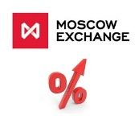
MOEX SPONSORED ACCESS OVERVIEW
MOEX
Individuals (> 720 000)
Legal Entities (> 11 000)
Institutional Investors (>4 000)
Financial Institutions & FI's Clients (> 600)

Slide 8
FX INSTRUMENTS AND TRADING HOURS
10:00
Until 23:50
SWAPS:
USD/RUB, EUR/RUB: TOMSPT, 1W-1Y
CNY/RUB: TOMSPT, 1W-6M
EUR/USD, HKD/RUB, GBP/RUB: TOMSPT
TOM:
USD/RUB
EUR/RUB
EUR/USD
CNY/RUB
HKD/RUB
GBP/RUB
LTV forwards:
USD/RUB
EUR/RUB
CNY/RUB
Until 17:15
TOD:
USD/RUB ***
Until 15:00
TOD:
EUR/RUB
EUR/USD
UAH/RUB
GBP/RUB
O/N SWAPS**
Until 11:00
TOD:
CNY/RUB
HKD/RUB
BYR/RUB
KZT/RUB
O/N SWAPS*
* Including overnight SWAPs (BYR, CNY, HKD)
** Overnight SWAPs – until 15:15
*** Overnight SWAPs - until 17:30

Slide 9
Disclaimer
This presentation has been prepared and issued by Open Joint Stock Company MOSCOW EXCHANGE (the “Company”). Unless otherwise stated, the Company is the source for all data contained in this document. Such data is provided as at the date of this document and is subject to change without notice.
This document does not constitute or form part of, and should not be construed as, an offer or invitation for the sale or subscription of, or a solicitation of any offer to buy or subscribe for, any securities, nor shall it or any part of it or the fact of its distribution form the basis of, or be relied on in connection with, any offer, contract, commitment or investment decision relating thereto, nor does it constitute a recommendation regarding the securities of the Company.
The information in this document has not been independently verified. No representation or warranty, express or implied, is made as to, and no reliance should be placed on, the fairness, accuracy or completeness of the information or opinions contained herein. None of the Company, or any of its subsidiaries or affiliates or any of such person's directors, officers or employees, advisers or other representatives, accepts any liability whatsoever (whether in negligence or otherwise) arising, directly or indirectly, from the use of this document or otherwise arising in connection therewith.
This presentation includes forward-looking statements. All statements other than statements of historical fact included in this presentation, including, without limitation, those regarding our financial position, business strategy, management plans and objectives for future operations are forward-looking statements. These forward-looking statements involve known and unknown risks, uncertainties and other factors, which may cause our actual results, performance, achievements or industry results to be materially different from those expressed or implied by these forward-looking statements. These forward-looking statements are based on numerous assumptions regarding our present and future business strategies and the environment in which we expect to operate in the future. Important factors that could cause our actual results, performance, achievements or industry results to differ materially from those in the forward-looking statements include, among other factors:
perception of market services offered by the Company and its subsidiaries;
volatility (a) of the Russian economy and the securities market and (b) sectors with a high level of competition that the Company and its subsidiaries operate;
changes in (a) domestic and international legislation and tax regulation and (b) state policies related to financial markets and securities markets;
competition increase from new players on the Russian market;
the ability to keep pace with rapid changes in science and technology environment, including the ability to use advanced features that are popular with the Company's and its subsidiaries' customers;
the ability to maintain continuity of the process of introduction of new competitive products and services, while keeping the competitiveness;
the ability to attract new customers on the domestic market and in foreign jurisdictions;
the ability to increase the offer of products in foreign jurisdictions.
Forward-looking statements speak only as of the date of this presentation and we expressly disclaim any obligation or undertaking to release any update of, or revisions to, any forward-looking statements in this presentation as a result of any change in our expectations or any change in events, conditions or circumstances on which these forward-looking statements are based.

Slide 10
THANK YOU
Contacts:
Marc Millington-Buck
Marc.Millington-Buck@moex.com Tel. +44 20 7002 1393
Vladimir Yarovoy Vladimir.Yarovoy@moex.com Tel. +7-495-363-3232 ext. 26240
Alexander Ageev Alexander.Ageev@moex.com
Tel. +7-495-363-3232 ext. 26241

